Slide 1

2) Analytics Fundamentals: Part 2
Review of data, software, and statistics basics

Slide 2
Review of Statistical Tests
Hypothesis tests consist of three basic components
1) Hypothesis Statements: null (Ho) and alternative (H1)
2) Decision Rule: based on sample evidence (test statistic or p-value), what to conclude (Ho or H1)
3) The Decision
Note there are two types of errors that can be made:
Type I -concluding H1 when Ho is true. Alpha is the chance of a Type I error
Type II- concluding Ho when H1 is true. Beta is the chance of
a Type II error

Slide 3
Review of Statistical Tests
P-Value, or probability value for a test, is the chance of a more extreme sample result given Ho true.
P-values provide a very general way to conduct tests, and also measure the extent that the sample evidence is consistent with Ho.
For any test, the decision rule is as follows:
If P-Value < Alpha, conclude H1
Otherwise , conclude Ho.

Slide 4
Example:
In the past, the shares for 3 brands (A, B, and C) making up a particular market have been 20%, 30% and 50% respectively.
There is suspicion that the shares have changed. How can this be formally tested?
SPSS file Brand_share_Class_Example.sav
Has product selection data for 100 observations.

Slide 5
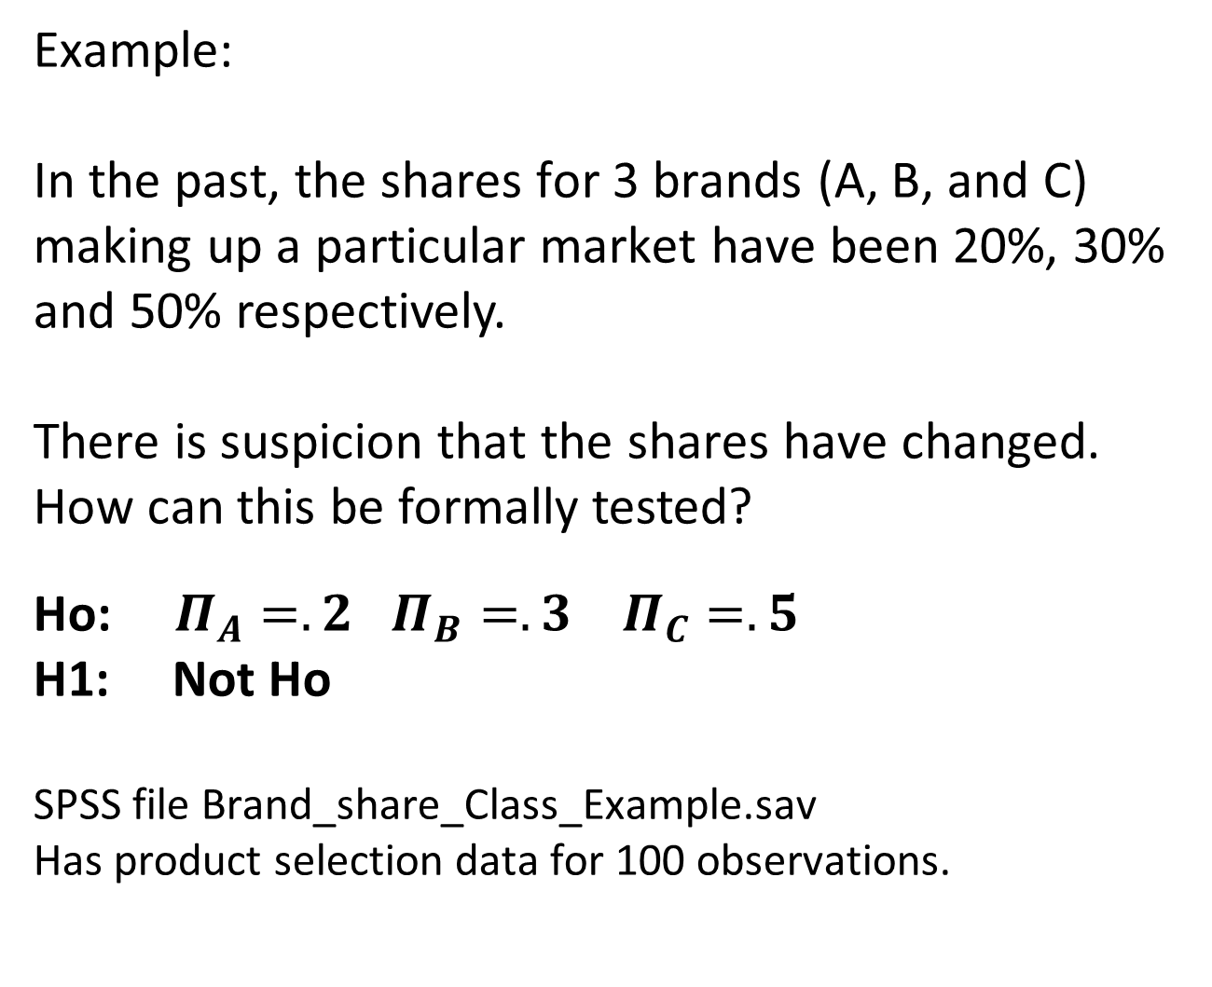
Example:
In the past, the shares for 3 brands (A, B, and C) making up a particular market have been 20%, 30% and 50% respectively.
There is suspicion that the shares have changed. How can this be formally tested?
Ho: $Π_{A}=.2$ $Π_{B}=.3 Π_{C}=.5$
H1: Not Ho
SPSS file Brand_share_Class_Example.sav
Has product selection data for 100 observations.

Slide 6
Ho: $Π_{A}=.2$ $Π_{B}=.3 Π_{C}=.5$
H1: Not Ho
63 is the Test Statistic and has a Chi-Square distribution under Ho.
The P-Value is the probability of a more extreme value than 63. To get that probability, use the Chi Square distribution with 2 degrees of freedom (degrees of freedom = number of rows in the table -1, so 3-1 =2 for our example.
P-Value = P(X² > 63), Using excel, =CHISQ.DIST.RT(63,2) = .000 So, P-Value = P(X² > 63) = .000
Using alpha = .05 our Decision Rule is : Conclude H1 if P-Value < .05, Else Conclude Ho,
Since P-Value = .000 < .05, the decision is Conclude H1

Slide 7
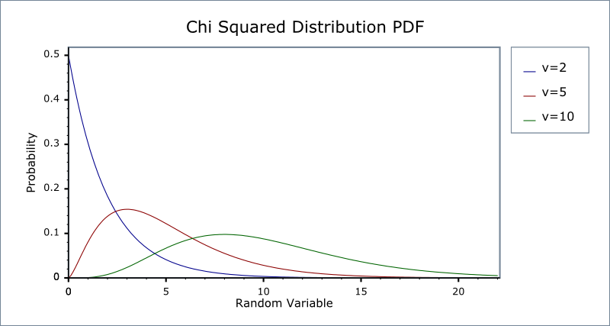

Slide 8
Review of Chi-Square tests for categorical data (or numeric data that has been categorized)
Chi-Square tests are versatile procedures useful for testing whether data conform to a theoretical distribution, and whether variables are independent.
The basic procedure is as follows: (1) Formulate the hypotheses (Ho,H1) , (2) Determine the data frequencies that you would expect if Ho (null) true, (3) Compare expected data freqs. with actual data freqs in your sample (using the Chi-square statistic). (4) Come to a conclusion using the Chi-square distribution.

Slide 9
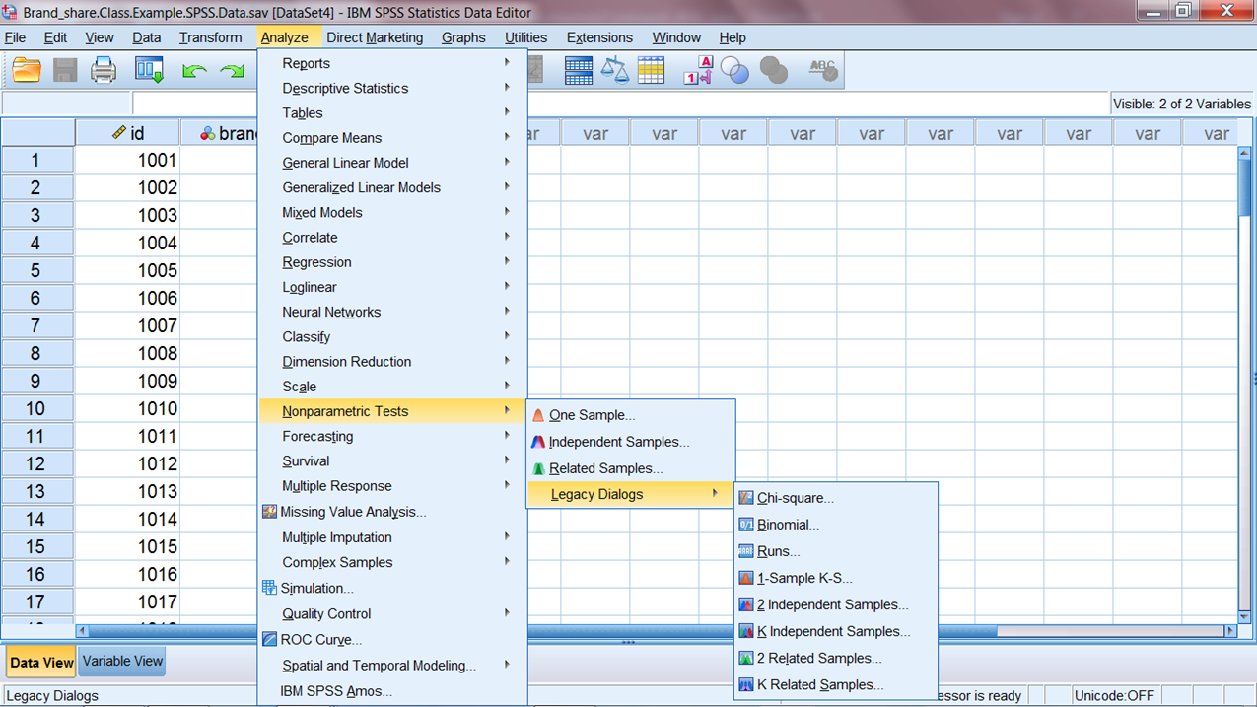
After loading the file, click Analysis, Nonparametric Tests, Legacy Dialogs, Chi-square

Slide 10
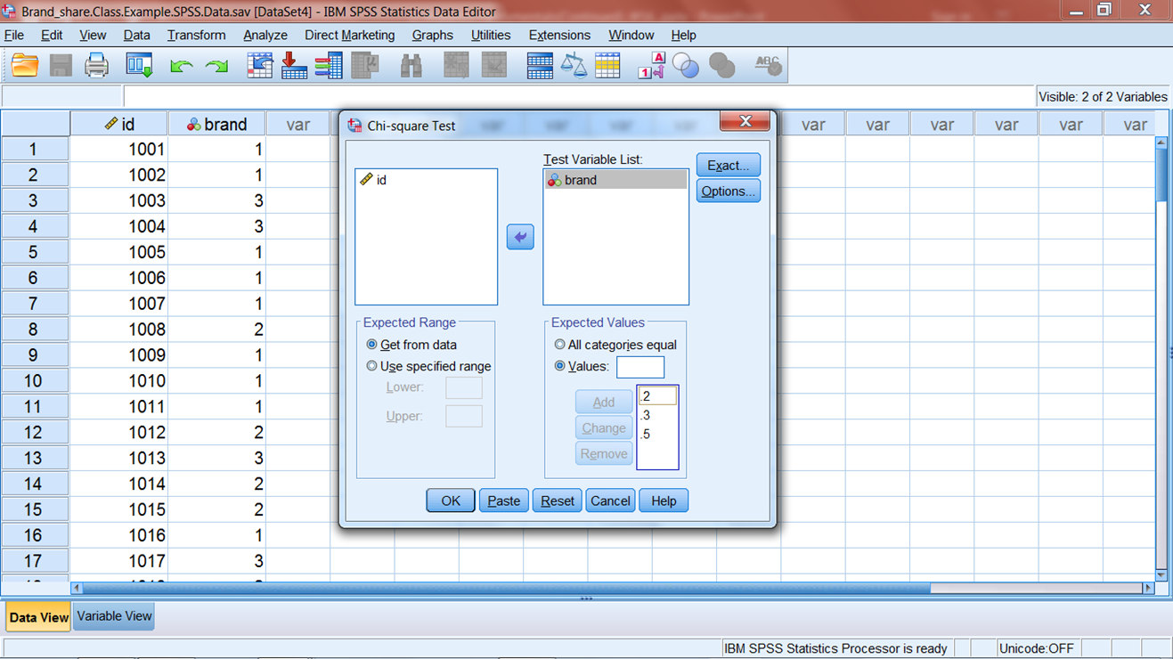
Enter the brand variable in the Test Variable List and specify the proportions in Ho. Click OK

Slide 11
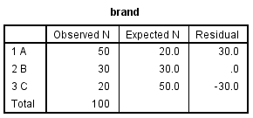
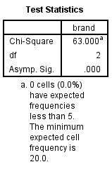
P-Value

Slide 12
Example.
Akers Brewery manufactures and distributes three types of beer: light, regular, and dark. In determining promotional strategy, a question has been raised as to whether beer preference among the three types is related to gender. If so, promotions will be tailored accordingly. A sample of 150 beer drinkers was selected and classified according to preferences.
Beer Preference
Light Reg. Dark Total
Male 20 40 20 80
Female 30 30 10 70
Total 50 70 30 150

Slide 13
Chi-Square test for independence
Ho: Beer preference is independent of gender
H1: Beer preference is not independent of gender
Test statistic = X² = S(f_{o} – f_{e})²/f_{e}
Where f_{e}= expected freq. under Ho = (row total*column total)/sample size
For large sample sizes (all expected freqs. at least 5), X² has a chi-square distribution with
degrees of freedom = (no. rows – 1)*(no. columns – 1)
Decision Rule: conclude H1 if p-value < alpha, else Ho.

Slide 14
Rationale of expected frequencies:
Recall if two events A,B are independent, then
P(A and B)= P(A)*P(B)
So, for example,
P(male and light beer pref)=P(male)*P(light)
=(80/150)*(50/150)=.178
And with a random sample of 150 we would expect
.178(150)=26.67 males that prefer light beer
Putting it together, (80/150)*(50/150)(150)
=(80*50)/150 = (row total*column total)/sample size.

Slide 15
Beer Preference f_{o} (f_{e})
Light Reg. Dark Total
Male 20(26.67) 40(37.33) 20(16.00) 80
Female 30(23.33) 30(32.67) 10(14.00) 70
Total 50 70 30 150
Test statistic = X² = S(f_{o} – f_{e})²/f_{e} = (20-26.67)²/26.67 + …+ (10-14.00)²/14.00
=6.13
Decision Rule: Conclude H1 if p-value < alpha=.05, else Ho.
P-value = P(X² > 6.13) = .0467. So, conclude H1 since .0467 < .05.
Using excel, =CHISQ.DIST.RT(6.13, 2) = .0467
d.f. = #rows -1)(#columns -1) = (2-1)(3-1)=2

Slide 16
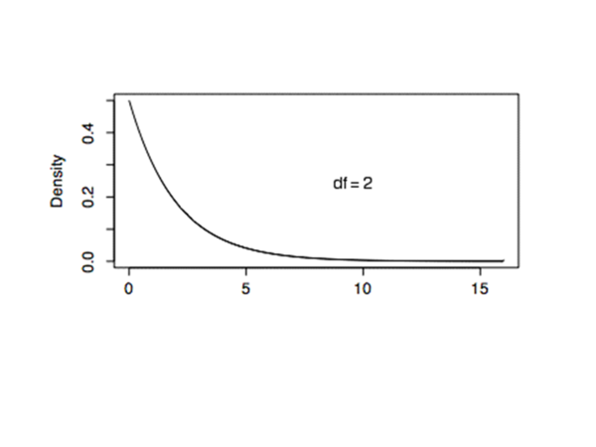

Slide 17
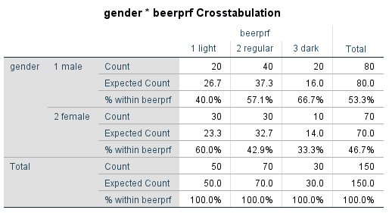

Slide 18
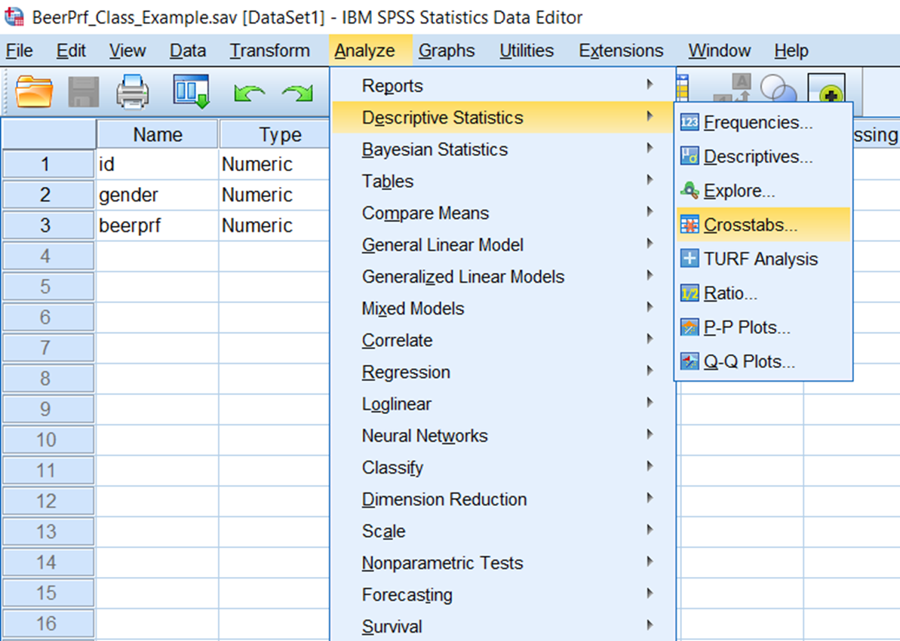
SPSS Screen Shots for Chi-Square test for independence class example (2_BeerPrf_Class_Example.SPSS.Data)

Slide 19
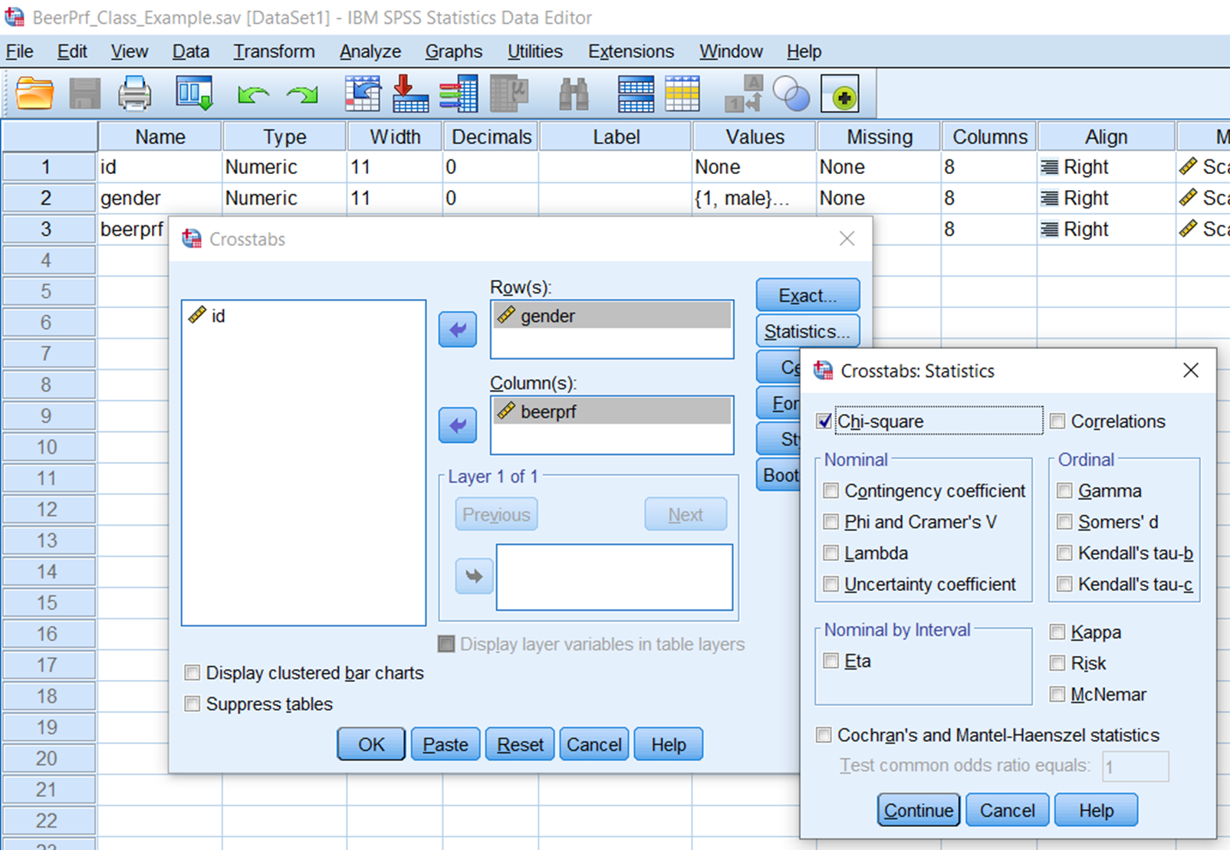

Slide 20
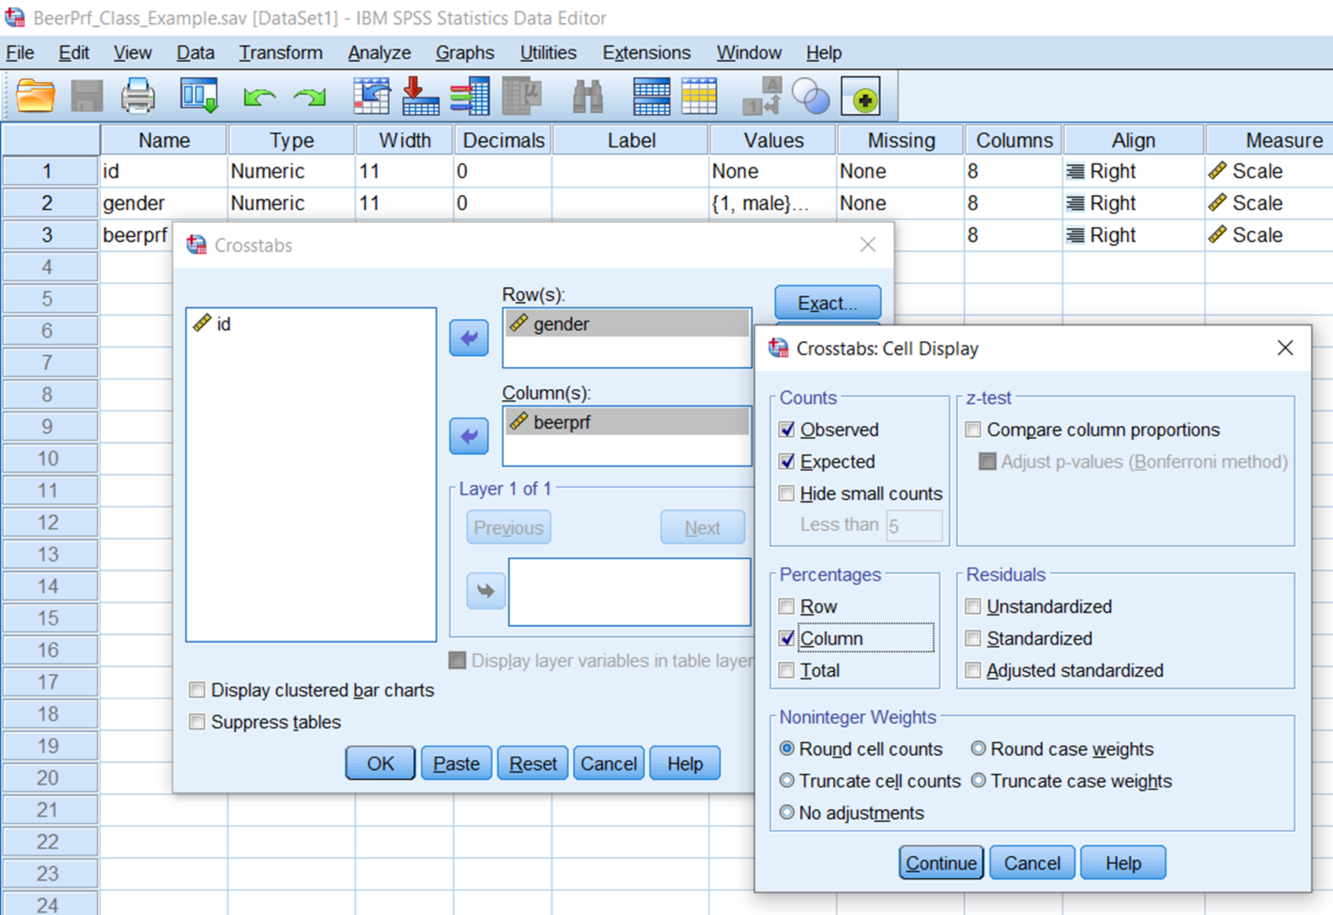

Slide 21
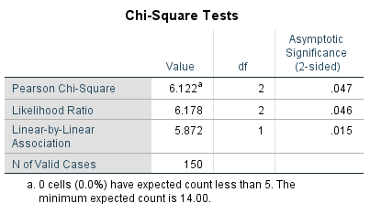

Slide 22
Example: A large manufacturer of salty snacks has developed a new type of potato chip that has been cooked a bit longer than conventional potato chips. The current plan is to have a national introduction with the same promotional campaign for all their markets.
A research manager is concerned about this approach, and believes there may be regional differences regarding preferences for the new chip compared to conventional chips.
A study is conducted where three independent samples of size 400 each are obtained from the northeast (1), southeast(2), and southwest (3). Respondents who were sampled from the target population were asked which of the two chips they prefer(new or conventional).
The resulting proportions of those favoring the new chip were as follows: p1=0.48, p2=0.46, p3=0.55. General management wants to stay with their original plan, and dismiss the results as just sample outcomes. What would you suggest?

Slide 23
Note in this example we want to test whether there are differences in the population proportions for the three different populations (regions)
Ho: all population proportions are the same
Ha: population proportions are not all the same
We can conduct this test using the same procedure that we used for tests of independence. The rationale is different but the computational procedure is identical. In general we can use that procedure for tests of differences of proportions for 2 or more populations.

Slide 24
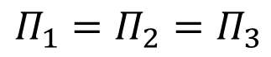
Test of Homogeneity
Ho: all population proportions are the same
H1: population proportions are not all the same
Test statistic = X² = Σ(f_{o} – f_{e})²/f_{e}
Where f_{e} = expected freq. under Ho = (row total*column total)/sample size
For large sample sizes, X² has a chi-square distribution with
degrees of freedom = (no. rows – 1)*(no. columns – 1)
Decision Rule: conclude H1 if p-value < alpha, else Ho.

Slide 25
Rationale for expected cell frequencies:
If all three regions have the same proportion favoring the new chip (Ho) our estimate for that proportion would be 596/1200 = .497 for the northeast, the expected cell frequency would be .497(400)=198.7
While the rationale is different from the test for independence, the resulting calculations are identical.

Slide 26

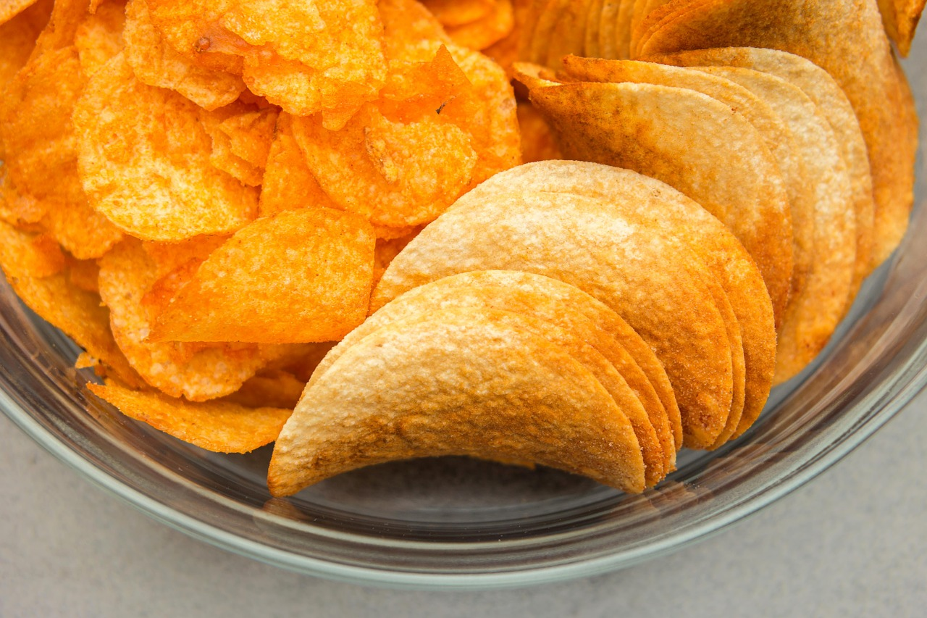
What do you conclude using a significance level of .05?
The data is saved in SPSS file “ChipsExample.sav”

Slide 27
Added Applications
4) Excel file FB_Survey.xlsx has data from a survey of students about number of hours online per week, number of FB friends, and gender. Import the file, label gender, and for each gender create histograms and descriptive statistics for the “hours online” and “friends” variables. In addition, estimate the mean hours online and friends with 95% confidence, for each gender (1=male, 2=female).

Slide 28
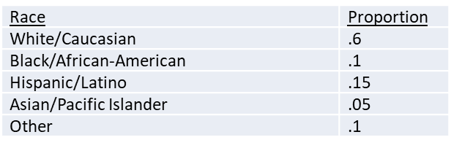
Added Applications
5) Piedmont Coffee produces coffee products along with various food items that it sells in its many store locations throughout the US. Piedmont recently conducted a study to investigate different aspects about consumer preferences and purchase intentions. A random sample of 200 coffee drinking consumers was selected to participate in the study. The questionnaire included questions about current coffee drinking habits and also routine demographic questions.
Information about the racial make up of Piedmont’s market has been obtained from secondary sources as follows:
Racial information was also collected in the questionnaire and provided in the SPSS data file Piedmont_1.sav in the variable “race”. As a check, perform an appropriate test using a significance level of 0.05 . State what you conclude, and why.
b) Respondents indicated whether they typically prefer light roast, medium roast, or dark roast coffee. Piedmont is interested in whether or not roast preference is independent of gender. SPSS data file Piedmont_1.sav has the responses to both the roast type preference (variable ‘roast’) question, and gender. Perform an appropriate test using a significance level of 0.05 . State what you conclude, and why. Also, interpret the results.

Slide 29
SAS Code for Class Examples
Dining Out Monthly Spending Example
proc import datafile="D:\_MARK_7600\Class_3\Data\do_spend.sav" DBMS=SAV OUT=do_spend;
run;
proc ttest data=do_spend ho=255 sides=2;
var ent_spend;run;
Brand Shares Example
proc import datafile="D:\_MARK_7600\Class_3\Data\brand_share_class_example.sav" DBMS=SAV OUT=bsce;
run;
proc freq data=bsce;
table brand/chisq testp=(.2 .3 .5);run;

Slide 30
SAS Code for Class Examples
Akers Brewery Example
proc import datafile="D:\_MARK_7600\Class_3\Data\beerprf_class_example.sav" DBMS=SAV OUT=bce;
run;
proc freq data=bce;
tables gender*beerprf/chisq expected norow nopercent;run;
*norow and nopercent supresses row and total %s, only show col. %s;
Chips Example
proc import datafile="D:\_MARK_7600\ Class_3 \Data\ChipsExample.sav" DBMS=SAV OUT=ce;
run;
proc freq data=ce;
tables pref*region/chisq expected norow nopercent;run;
*norow and nopercent suppresses row and total %s, only show col. %s;

